Slide 1
AR Foundation

Slide 2
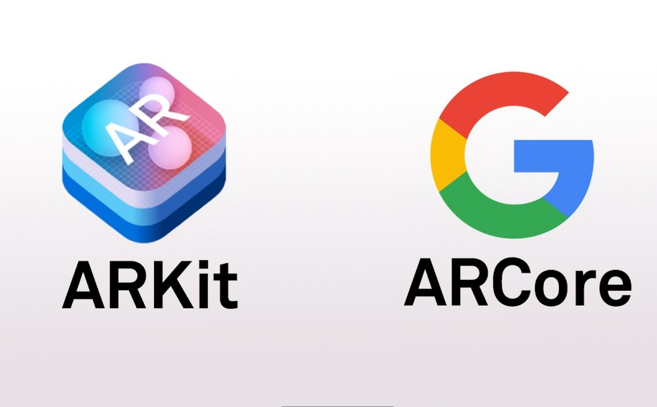

Slide 3
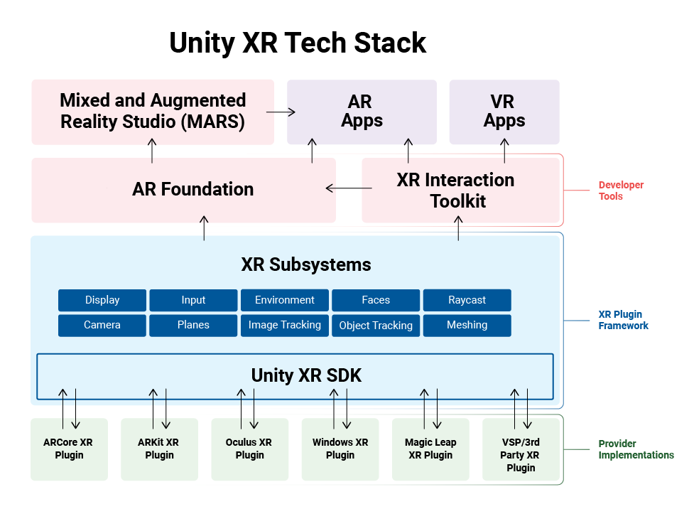

Slide 4
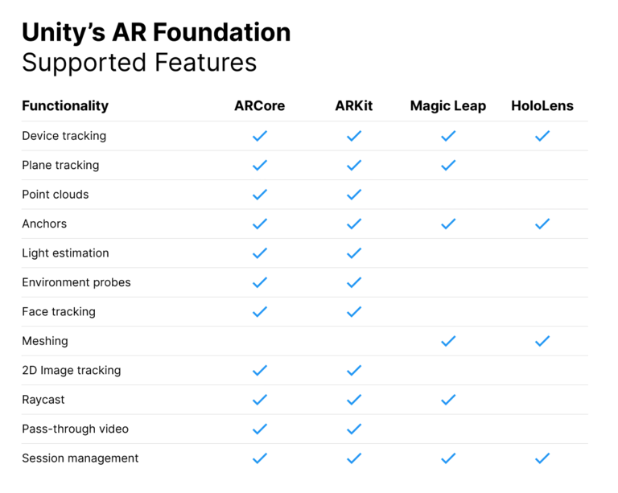

Slide 5
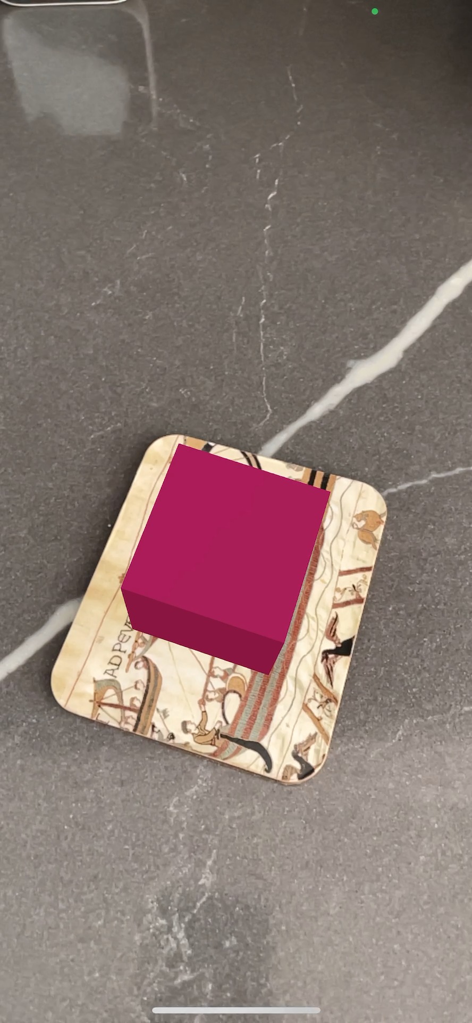

Slide 6
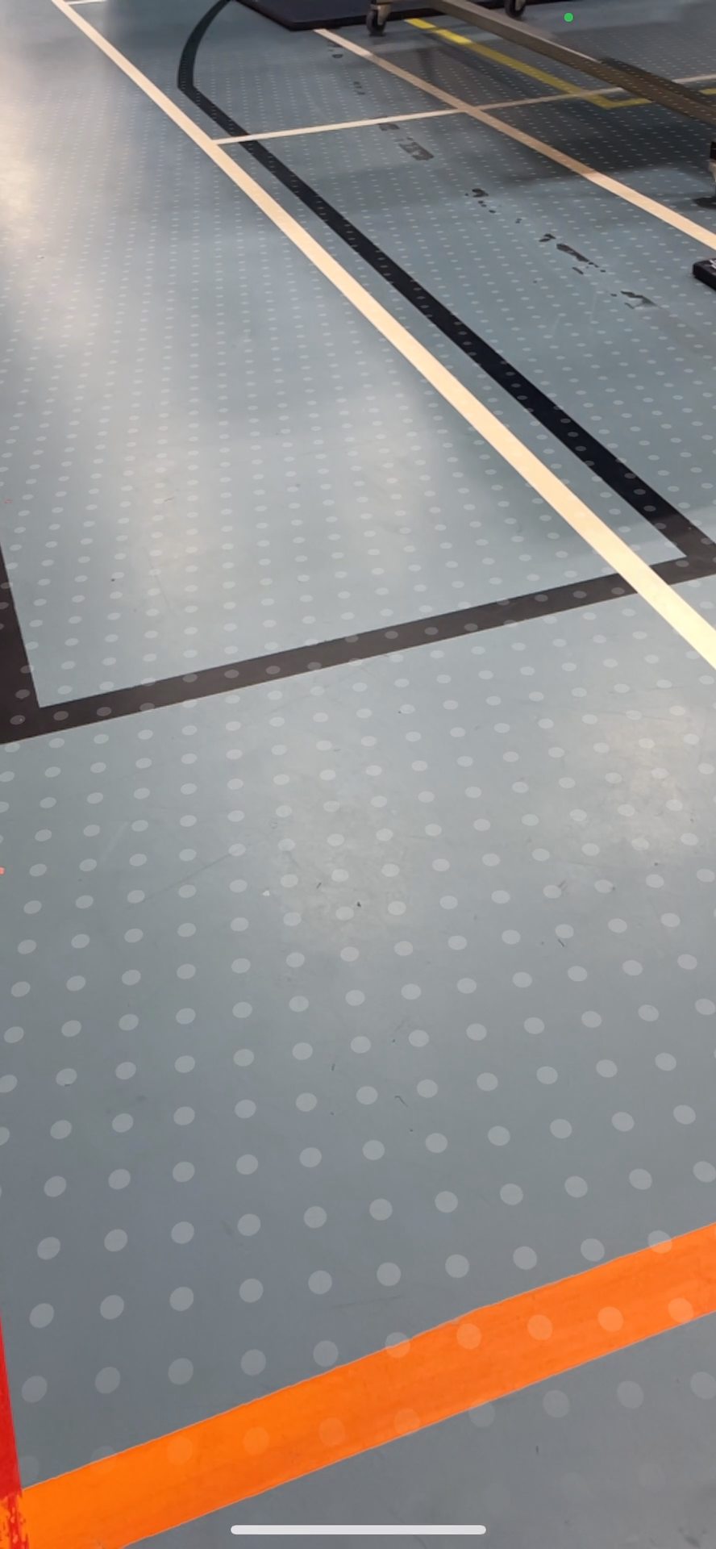

Slide 7
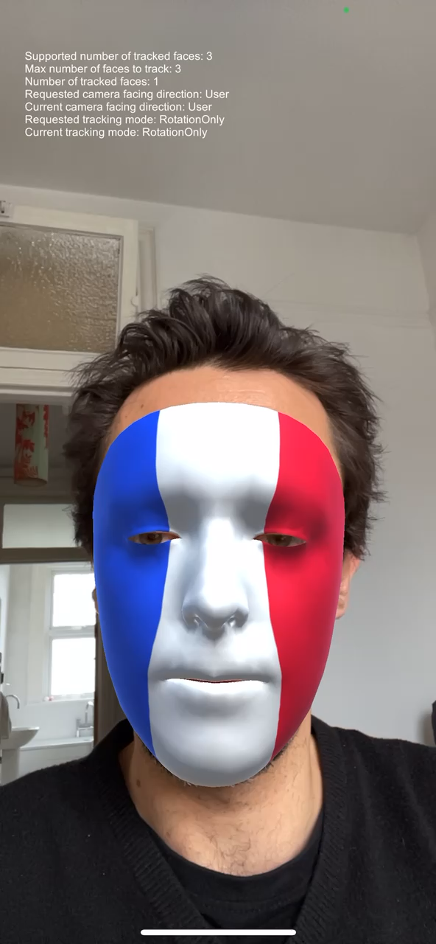

Slide 8
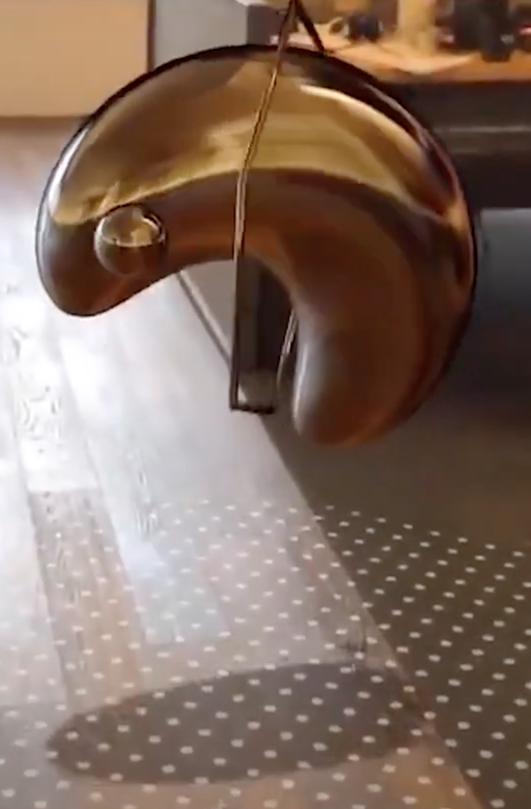

Slide 10
XR Interaction Toolkit

Slide 11
Interactables
AR Placement Interactable
AR Selection Interactable
AR Translation Interactable
AR Scale Interactable
AR Rotation Interactable

